Slide 1
I and Myself

Slide 2
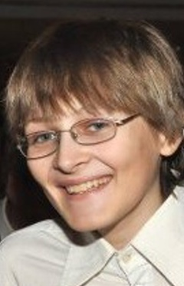
Basic
Name: Jakub
Date of Birth: 14. 10.
Age: 15
Live in: Czech Republic
Parents: have
Sisters: have
Brothers: haven‘t
Hobbies: Mountain Biking, Chess, Accordion and Watching Serials
Favourite collor: Green

Slide 3
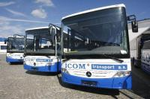
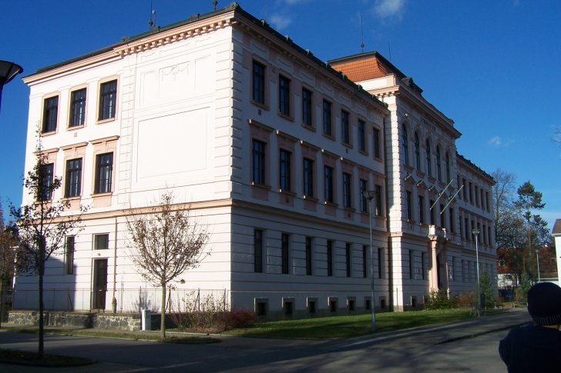
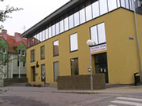
Ordinary Day
6:15 – 6:30 – Wake up
6:40 – Go to the bus
7:05 – Go to the school from the bus
7:10 – 7:59 – Waiting to a start school
8:00 – 13:20 – Be in the school
13:30 – Have a lunch in school canteen

Slide 4
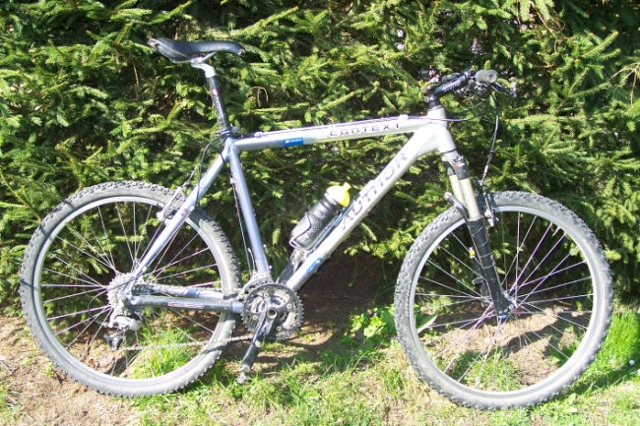
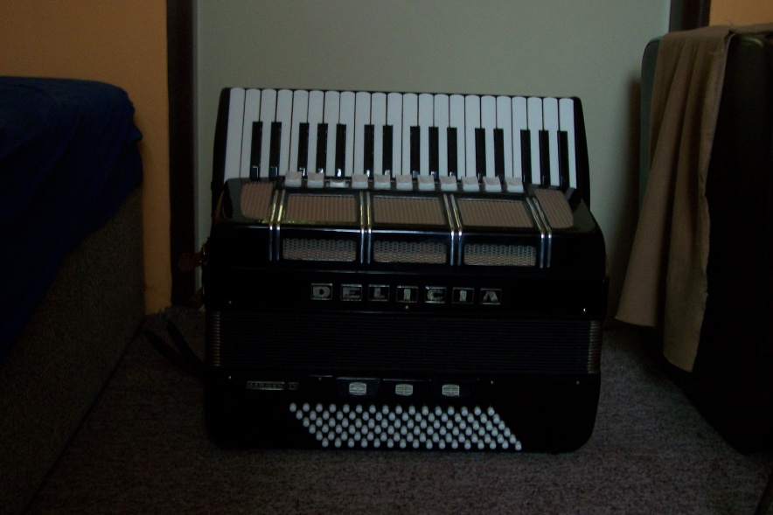
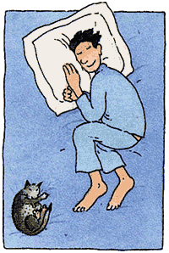
14:40 – Go home by bus
15:30
  Nice weather:
    Ride by bike to the neighbourhood
  Bad weather:
    Be on computer
17:30 – Play accordion
18:00 – Be on computer
19:30 – Have a dinner
22:15 – Go to the Bed
Neighbourhood - okolí

Slide 5
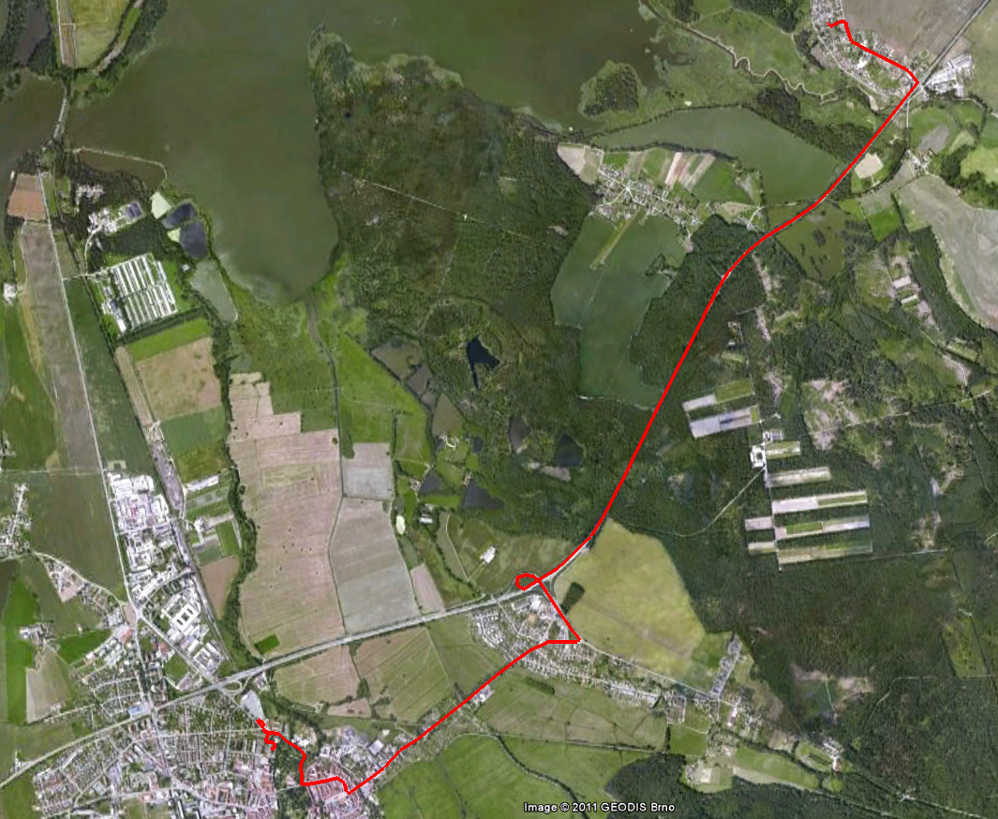
Way to the school

Slide 6

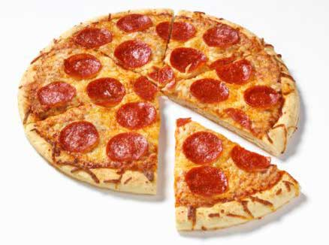

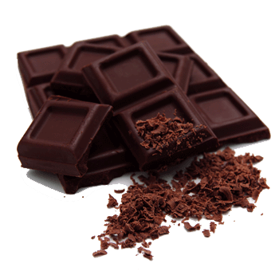
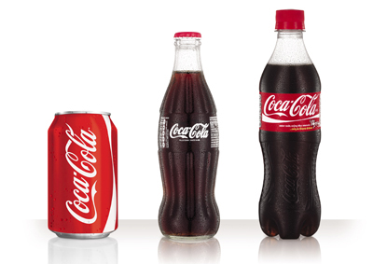
Food

Slide 7
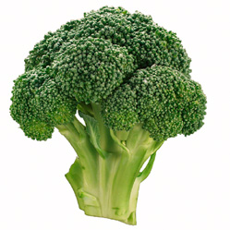
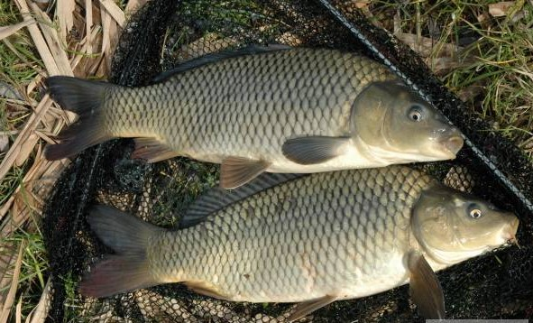
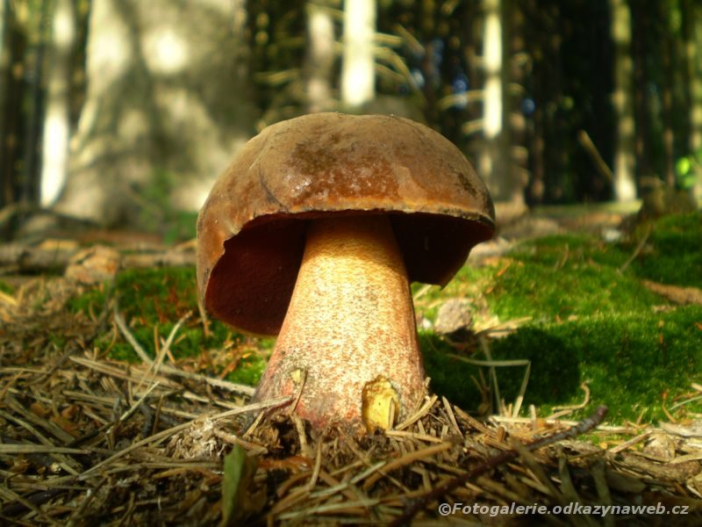
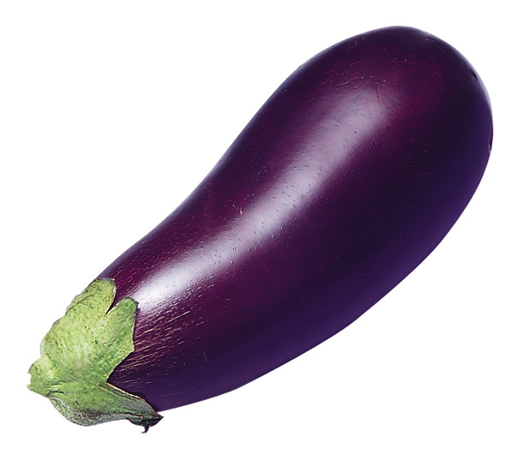

Slide 8
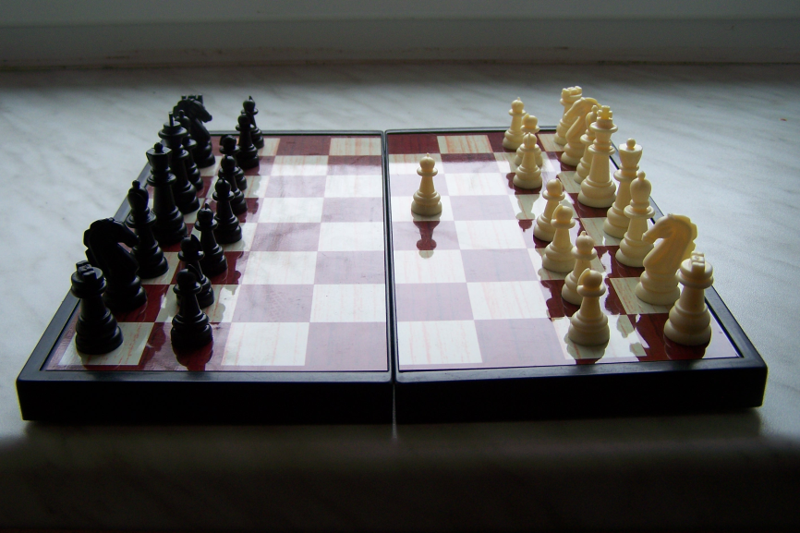

Hobbies

Slide 9
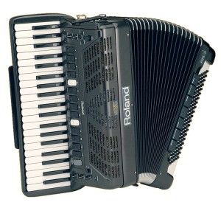
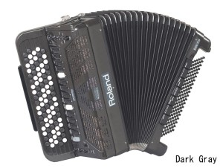
Accordion
1822 - First accordion by Friedrich Buschmann
Keyboard Accordion or Button Accordion

Slide 10
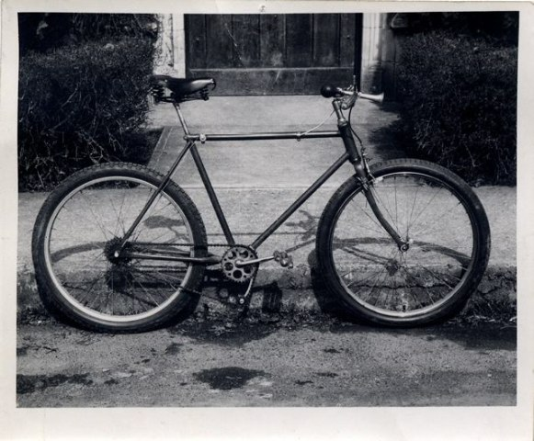
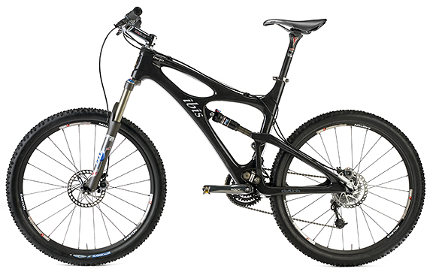
Mountain Biking (MTB)
1896 first bike adapted to terrain
In 70. and 80. years last century started Gary Fisher with the first serial production

Slide 11

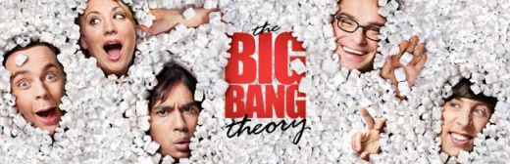


Serials
Scrubs
How I met your mother
Big bang theory
Naruto

Slide 12


Films
How to train your dragon
The lord of the rings 1-3

Slide 13
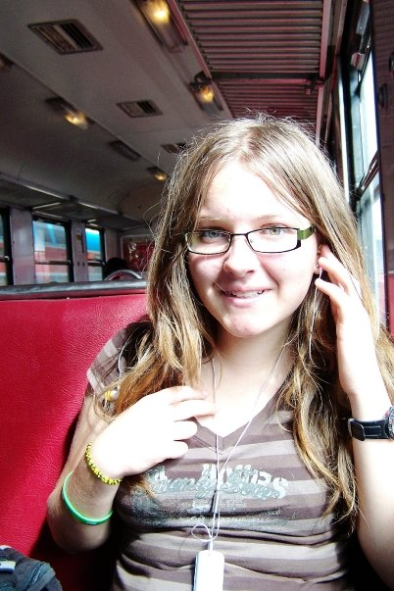
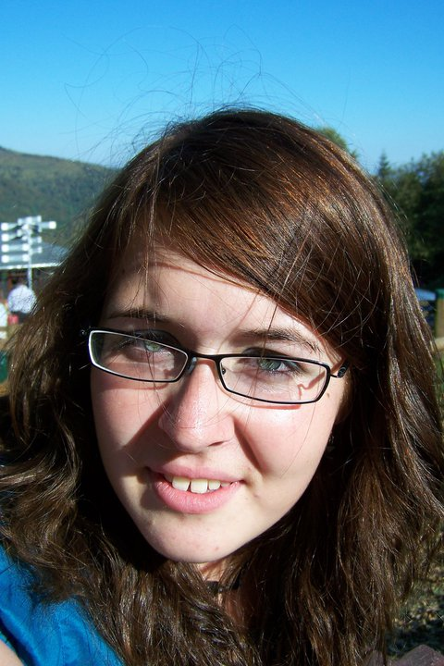
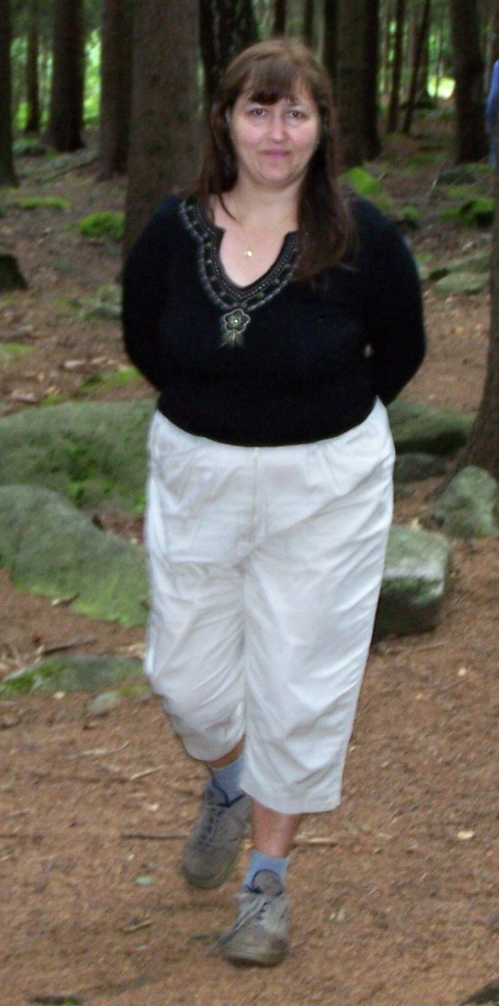
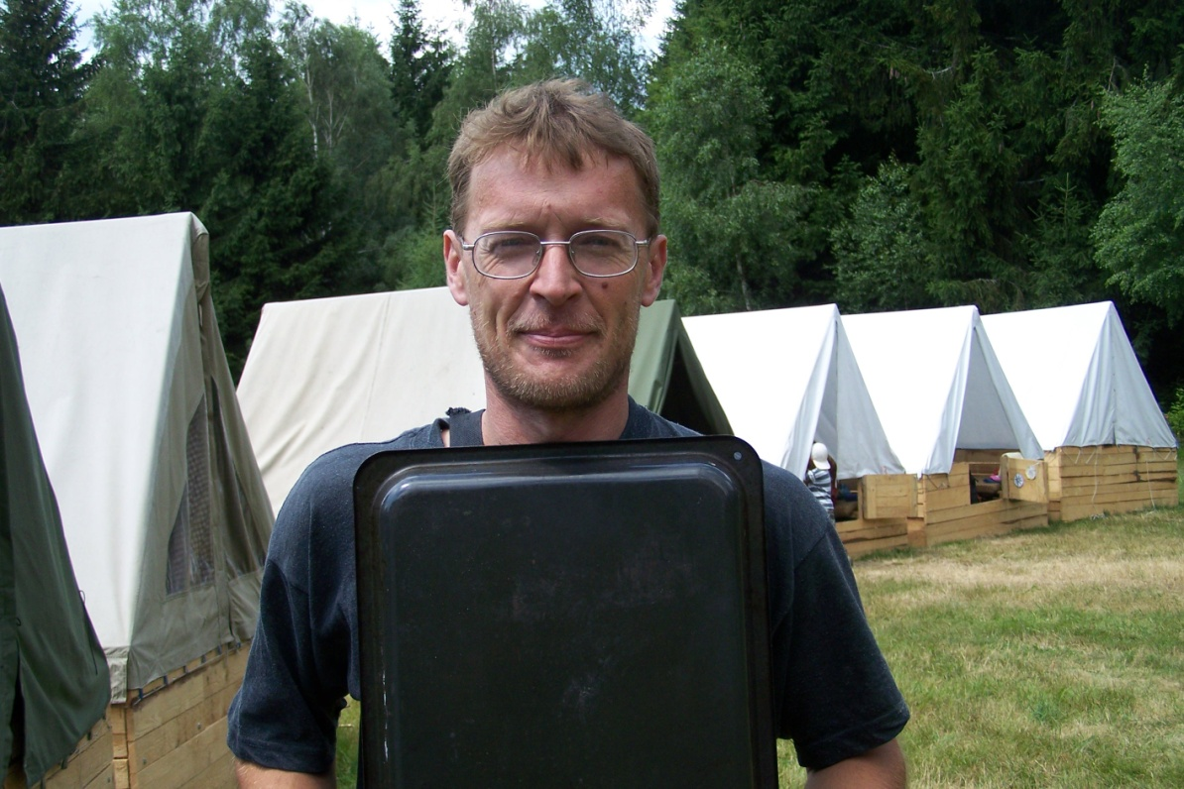
Family
Supervisory - dozorčí

Slide 14
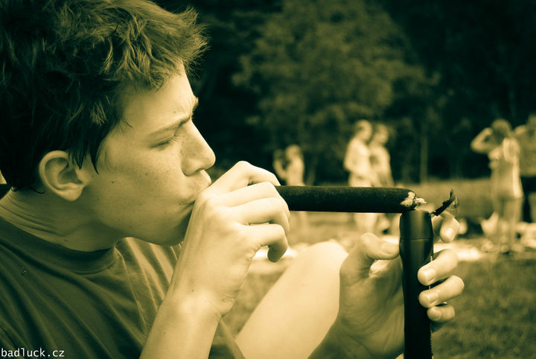
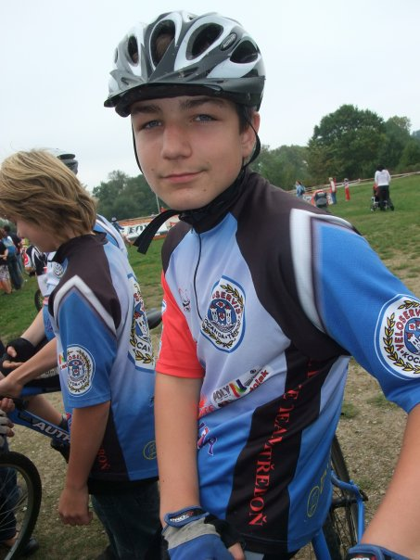
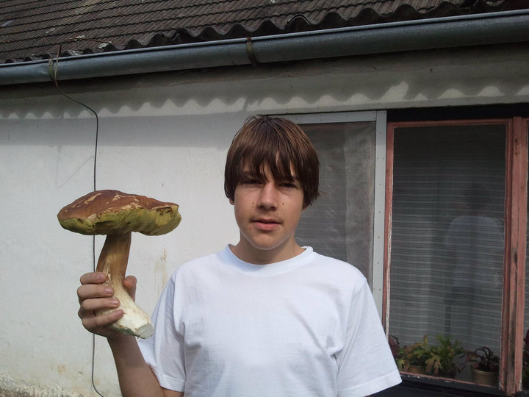
Friends

Slide 15
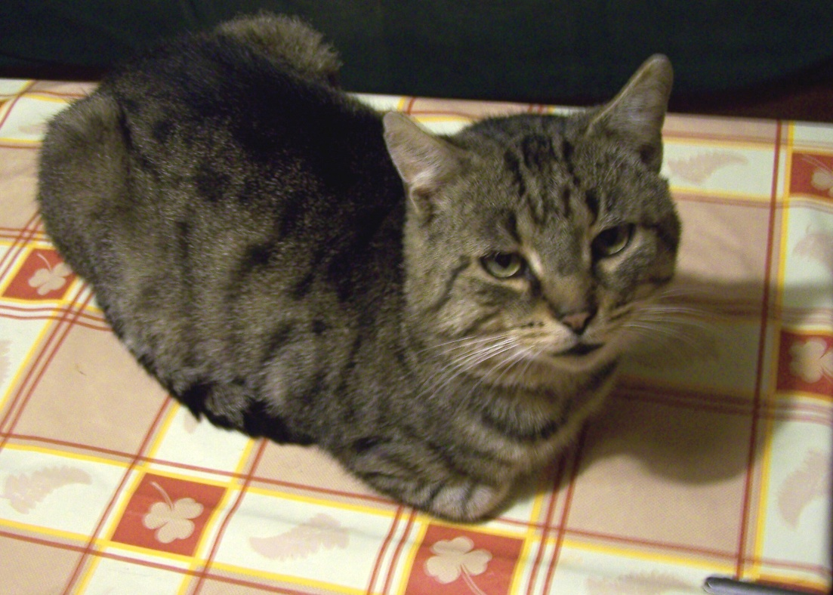
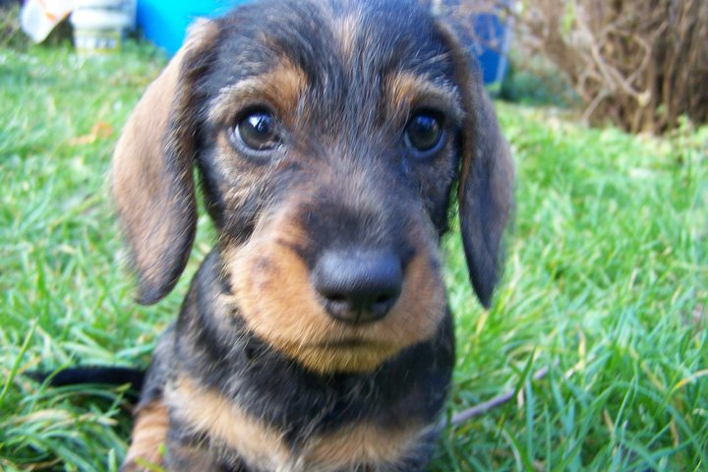
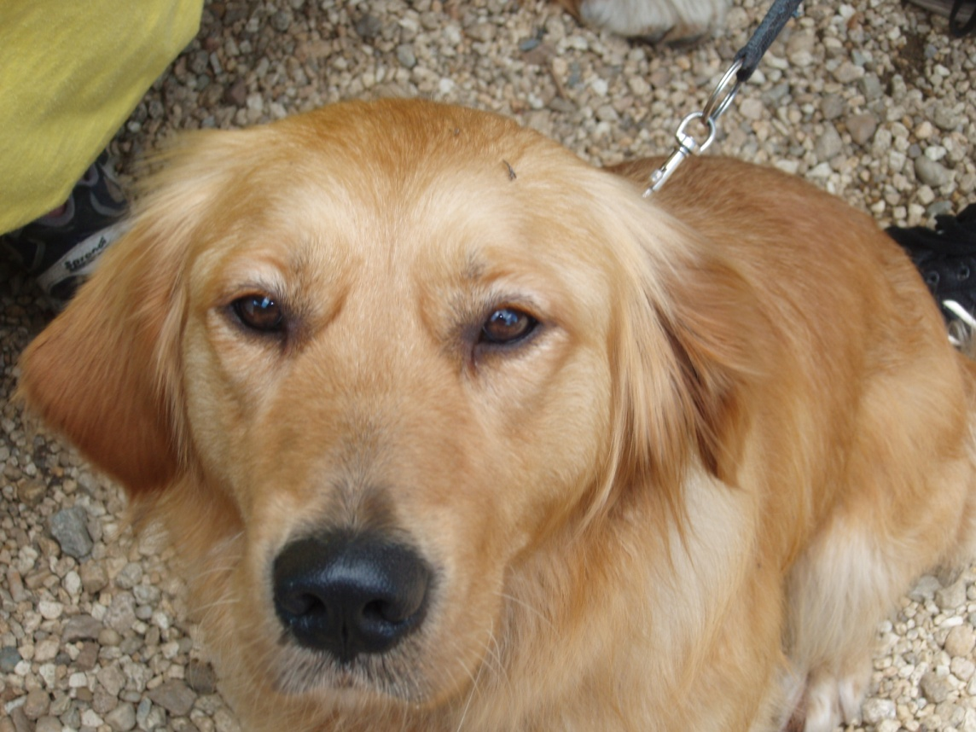
Pets
Dachshund - jezevčík

Slide 16
Sources
http://cs.wikipedia.org/wiki/Akordeon
http://cs.wikipedia.org/wiki/Horsk%C3%A9_kolo
http://www.akordeoncentrum.cz/roland/rolandfr5_7.htm
http://www.singletracks.com/blog/mtb-events/prof-jf-scott-to-be-inducted-into-mtb-hall-of-fame-this-month/
http://bicycling.com/blogs/toolbox/tag/carbon-mountain-bike-reviews/
http://pizzacb.webnode.cz/jidelni-listek/pizza/
http://zena-in.cz/clanek/redakcni-test-novych-susenek-bebe-dobre-rano-lesni-ovoce-a-svestkove-s-rozinkami/kategorie/jak-jsme-testovali
http://www.moa-jc.cz/studentska_spolecnost_merkur/sortiment.html

Slide 17
http://ct-akvarius.webnode.cz/news/kapr-obecny/
http://www.mineralfit.cz/diety-a-cviceni-clanek/lekce-ne-prejidani-550
http://fotogalerie.odkazynaweb.cz/detail/hrib-kovar
http://www.eshop-rychle.cz/bedynkydomu-cz/eshop/8-1-Dalsi-nabidka-ovoce-a-zeleniny/0/5/11-Lilek
http://www.autobusovenoviny.cz/archiv/2007-09
http://www.sjcentrum.cz/Galerie.aspx
http://www.rlslog.net/the-big-bang-theory-s04e20-hdtv-xvid-asap/
http://www.rlslog.net/how-i-met-your-mother-s06e20-hdtv-xvid-lol/
http://www.hyperobots.com/tag/scrubs/
http://nazret.com/blog/index.php/2008/11/15/ethiopia_to_export_bananas

Slide 18
http://chalupaudedka.webnode.cz/zahradnictvi/zelenina/
http://achia.blog.cz/rubrika/spanek-a-sny
http://www.scenicreflections.com/download/184556/How_to_Train_Your_Dragon_-_4_Wallpaper/
http://ramascreen.com/the-lord-of-the-rings-trilogy-extended-editions-blu-ray-arrives-this-year/
And myself of curse

