Slide 1
Me… Me… Me…
About me and my lifestyle

Slide 2
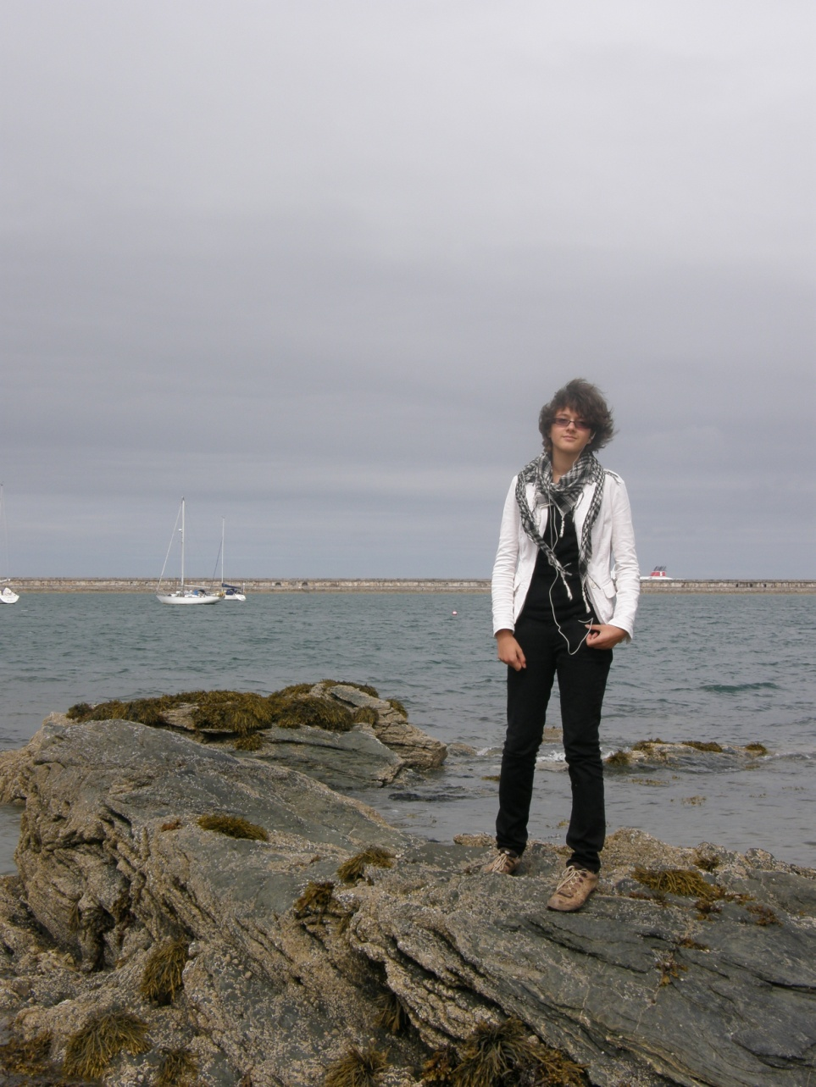
About me
Name: Klára
Date of birth: 1996
From: Lužnice
Best friend: Klára
Favourite colour: Green
Favourite drink: Kofola
Favourite food: Pizza
Hobbies: travelling, music…

Slide 3
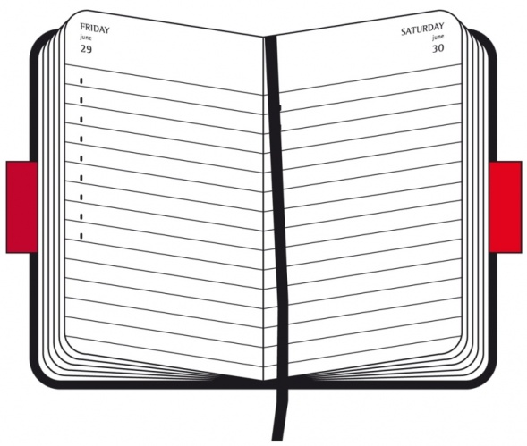
My day - Tuesday

Slide 4
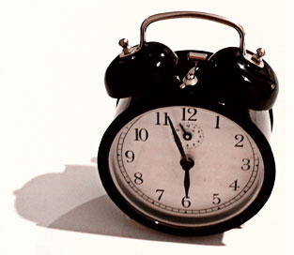

Morning
Get up at 6 a.m.
I dress up
Breakfast
  Cornflakes, coffee with milk
Running to bus

Slide 5
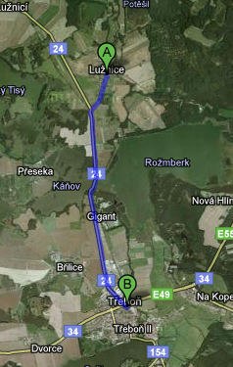


Way to school
By bus/ by bike (in spring)
Form: Lužnice
To: Třeboň
Distance 10 km

Slide 6
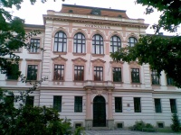
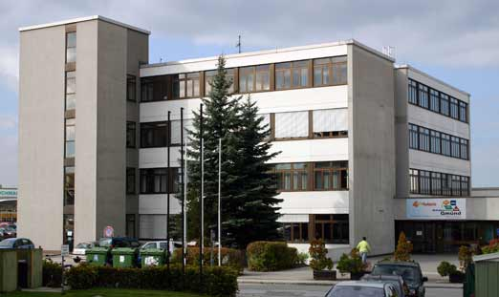
School
Start: 8.00
End: 14.25 (usually)
In kvarta
a) I like this subjects
  Maths, Biology, English, German
b) I hate this subjects
  Czech, Chemistry, PC
I want to study in Austria
next year

Slide 7
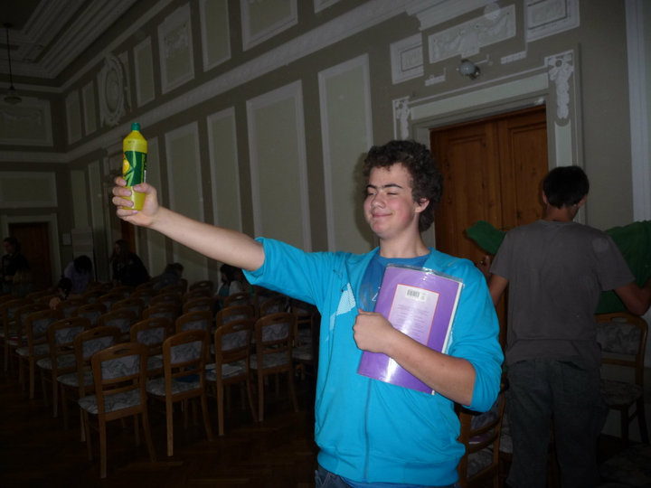
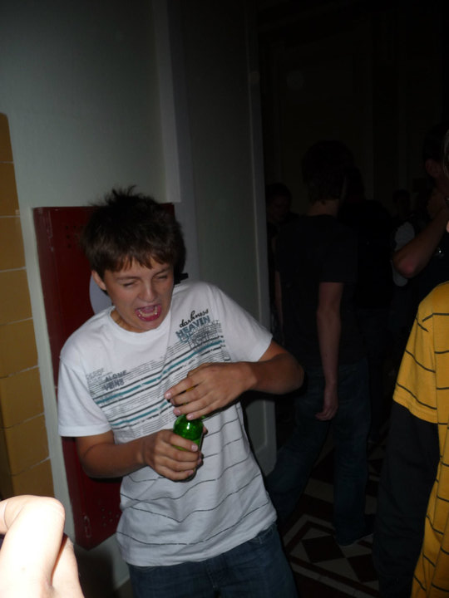
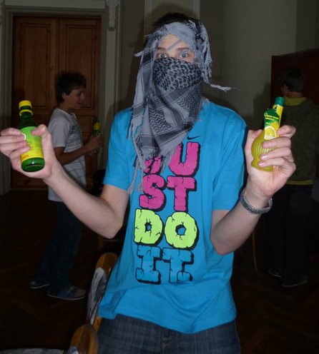
Our class
Very funny
Crazy ideas:
drinking lemon
juice

Slide 8

After School
14.25 – 17.00
Lunch in school dinind-room
  Usually disgusting
  Hardly ever good
Nice weather
  In park with friends
  Playing with flying disc
Terrible weather
  In library
  Sitting on bus stop with my best friend

Slide 9
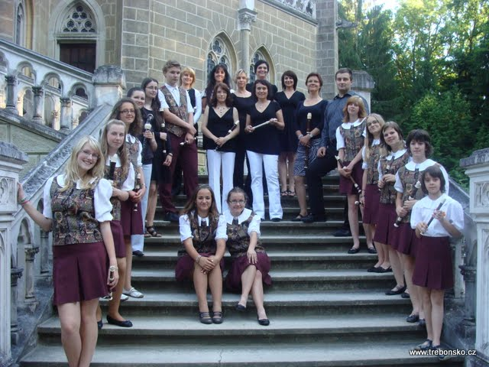
Flute ensemble – Třebonští pištci
17.00 – 18.30
Old music
About 15 full members
Concerts - every month
Flutes
  Soprano
  Alto
  Tenor
  Bass

Slide 10
My hobbies

Slide 11


Music
Piano
Like Bach music
    1) To listen
    2) To play
Flute
I have lesson every Wednesday
Organ
I like playing this (exotic) intstrument

Slide 12

Ultimate Frisbee
  Game with flying disc
Great teammates from our school
Totally fair play
Lot of running
History
  From America
  60‘s
  University students

Slide 13
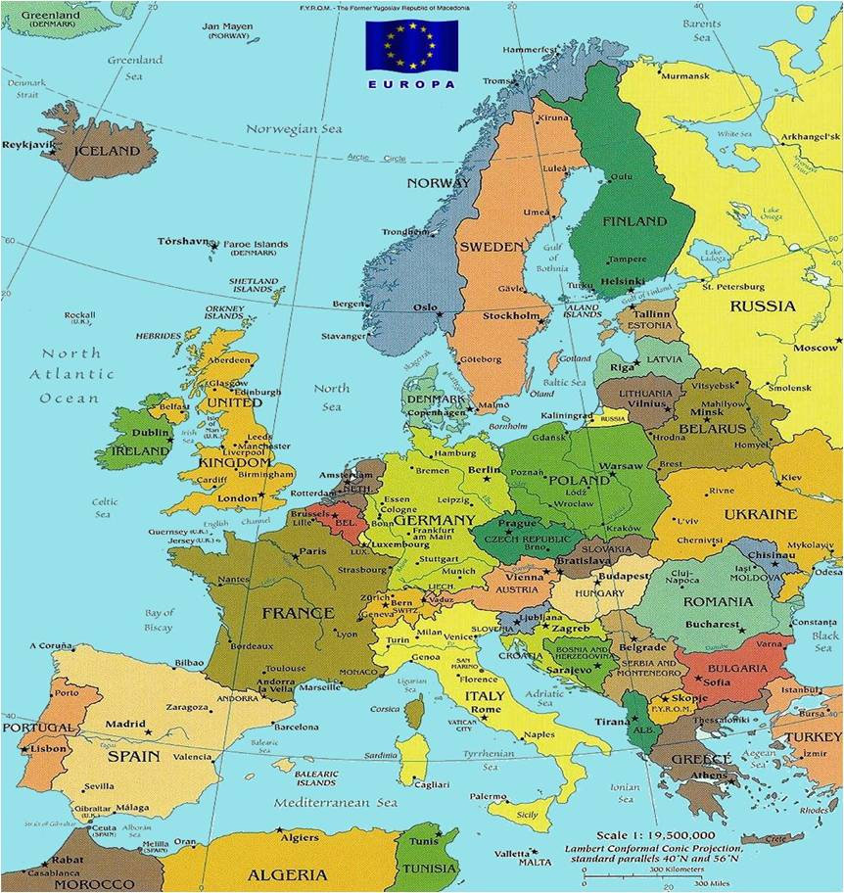
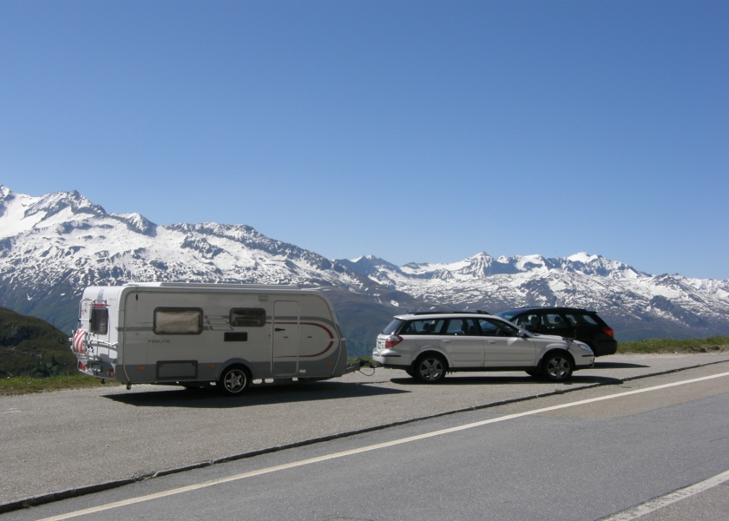
Travelling
With my family
With caravan
European countries
The nices country, I have ever been: Switzerland

Slide 14



Oustide sports
Snowboard
In-line skates
Bike

Slide 15
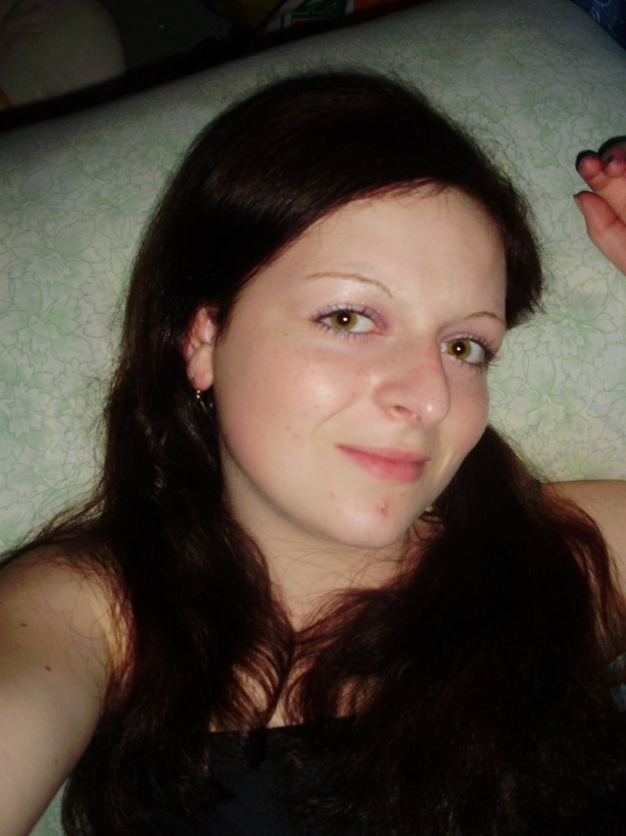
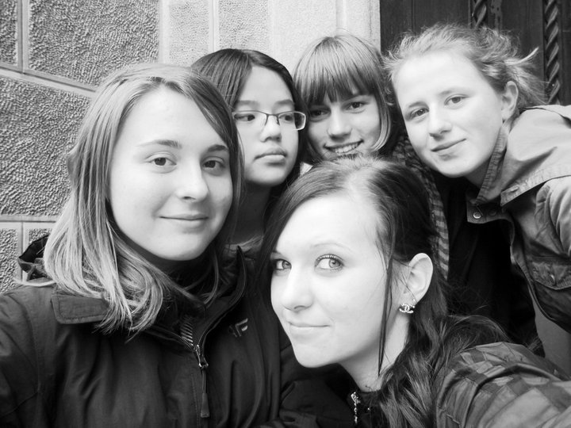
Friends
I Like tattling with them

Slide 16
Food

Slide 17
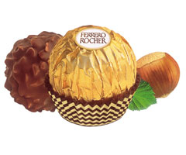
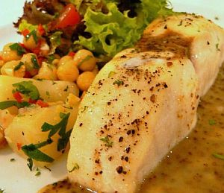
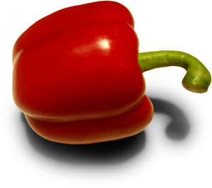

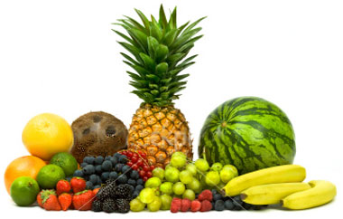
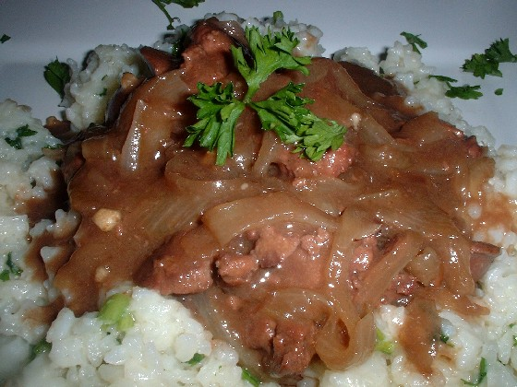
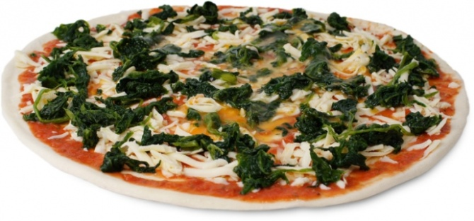
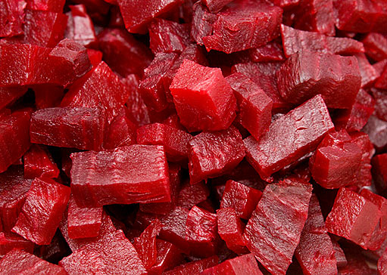
Don‘t like
I like

Slide 18
My family

Slide 19
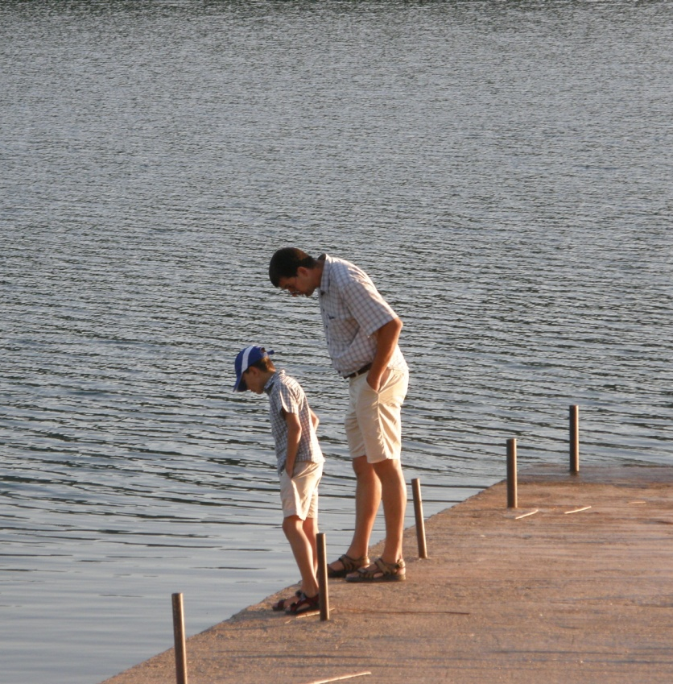
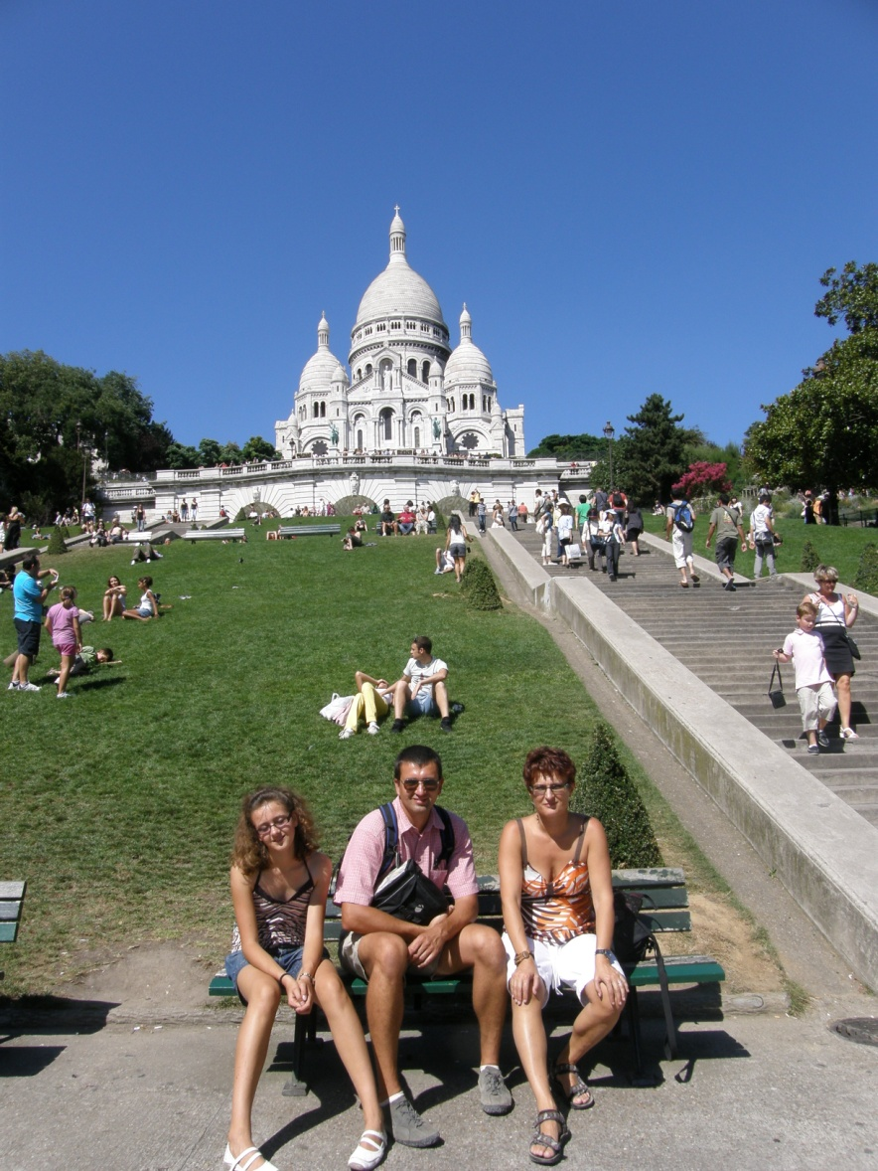
My family
Brother
Dad
Mum

Slide 20
Sources
http://en.wikipedia.org/wiki/Ultimate_(sport)#See_also
Google Earth
My head

