Slide 1
My style of life
„Honzík“ Nguyen

Slide 2
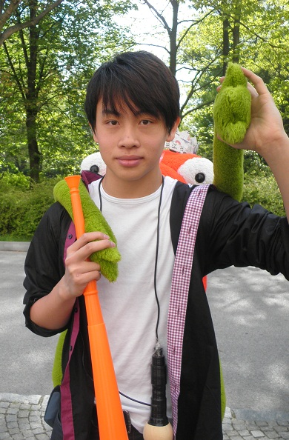
About me!
Name: Honzík
Age: 15
Place: České Velenice
Nationality: Vietnamese
Birthplace: Český Krumlov
Hobbies: Music, Comedy films, etc.
Sister or brother: only brother

Slide 3


Favourit things
Writer: Anthony Horowitz
Color: black and white
Song: Determinate
Food: lobster

Slide 4
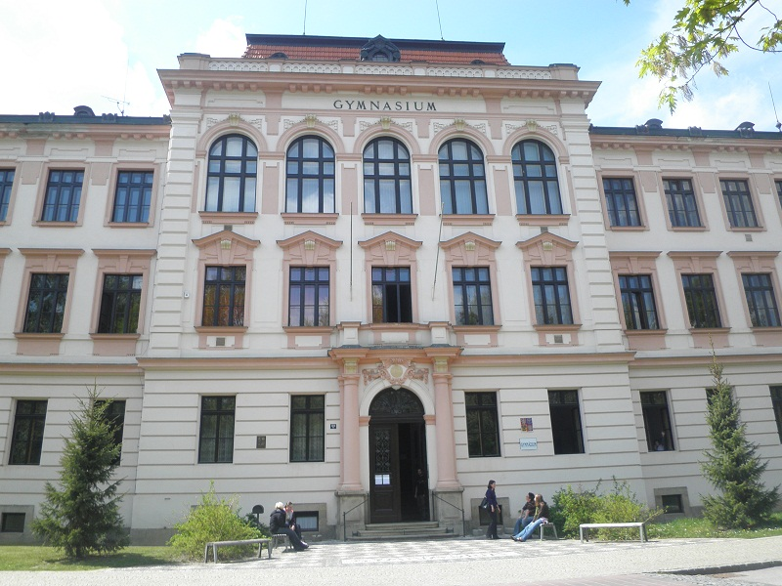
My school day
Tuesday
6:00 a.m.– get up
6:00 a.m.– go to the station
7:30 a.m.-go to school
8:00 a.m. - study in school
1:30 p.m. - school end and go to school kitchen

Slide 5
…
2:30 - 3:45 p.m. – Tutorage
4:12 p.m.– go home by train
5:00 p.m. – learning
6:30 p.m. – dinner
7:00 p.m. – go out with friends
9:00 p.m. – be on facebook
10:00 p.m. – sleep

Slide 6
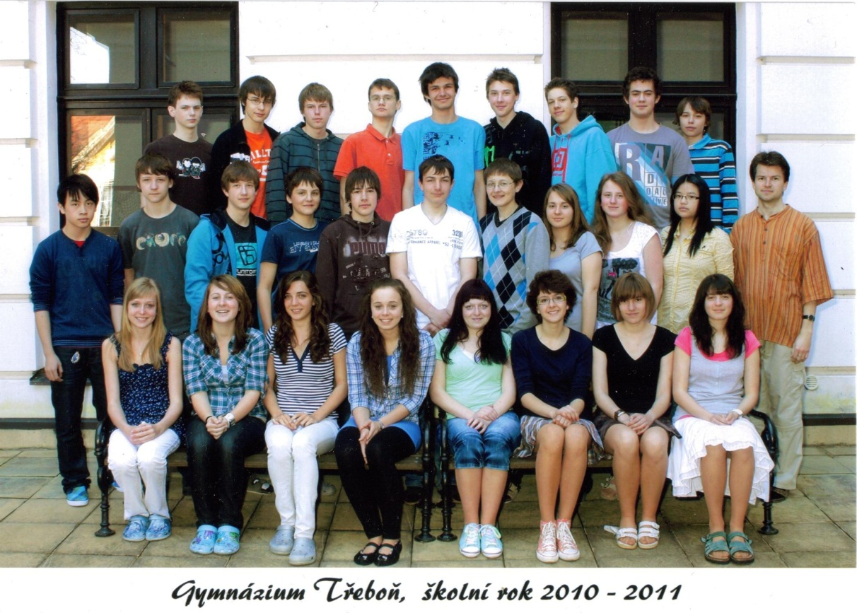
My school and my class
Gymnázium Třeboň
in quart
29 pupil
Favourite
subject:
Math, Chem.
I don‘t like History and Geografie

Slide 7
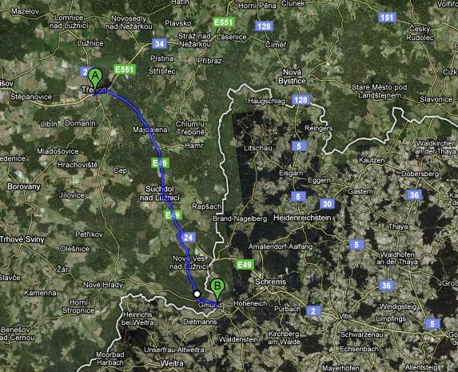
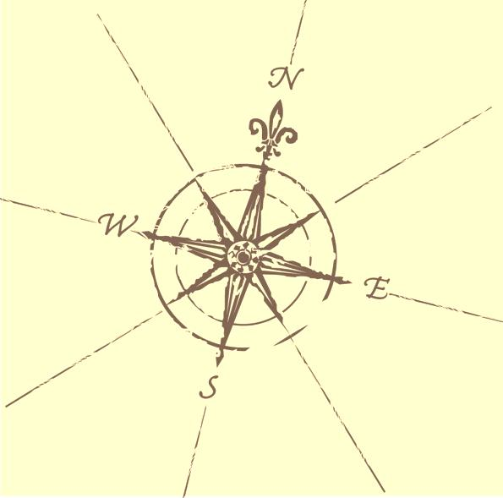
My way to school

Slide 8
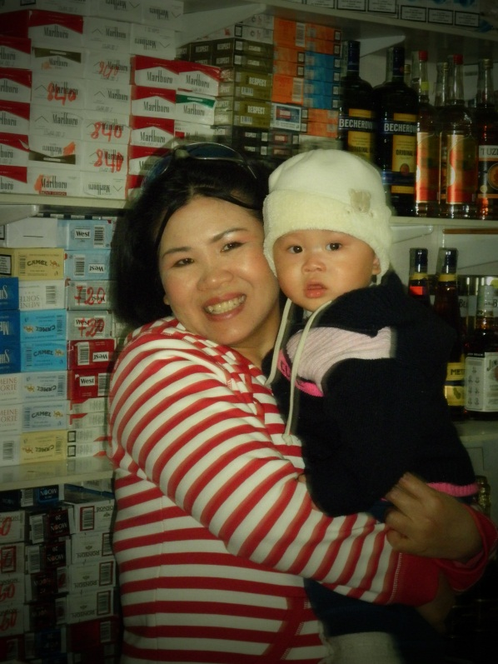
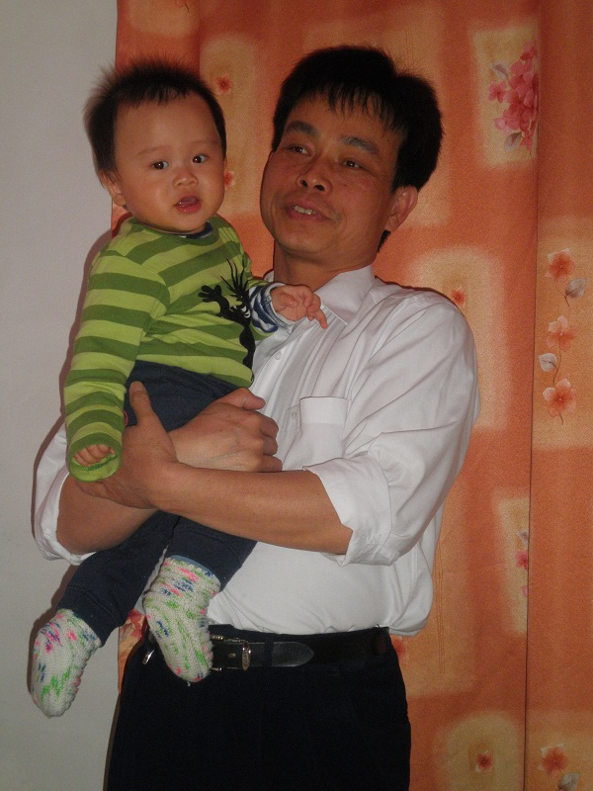
My Family
Dad
Age: 45
Like: football and working
Mother
Age: 37
Like: cooking
Brother
Age: 9 months
Like: sleeping and playing

Slide 9
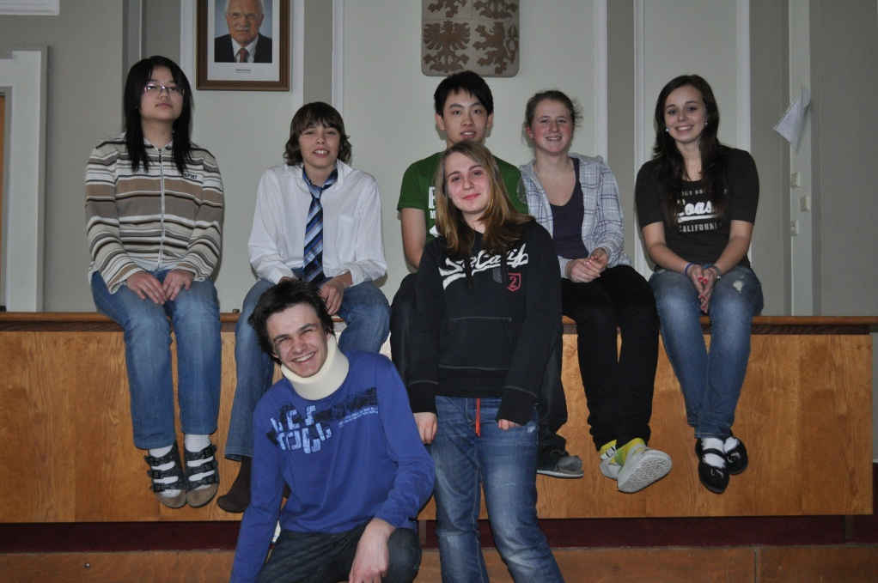
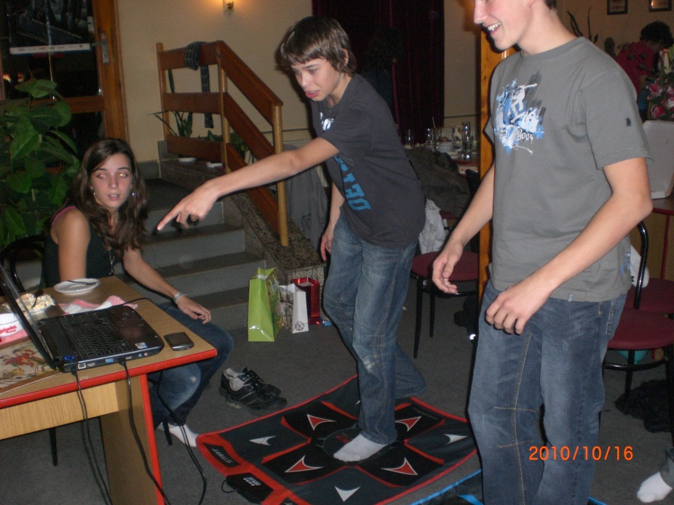
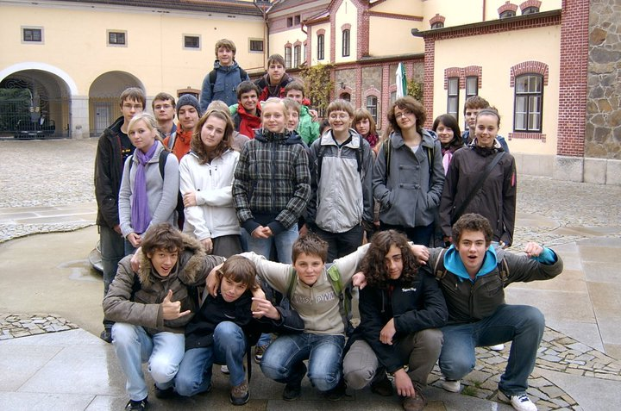
My friends and my class

Slide 10
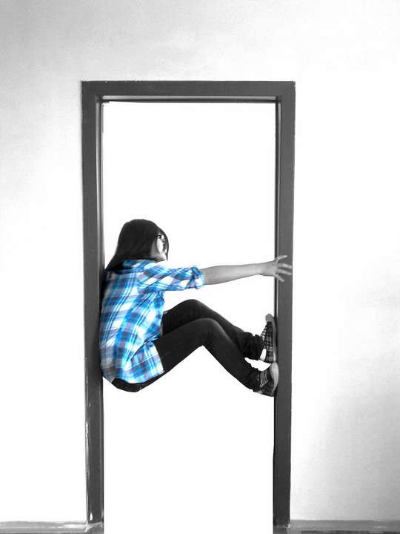
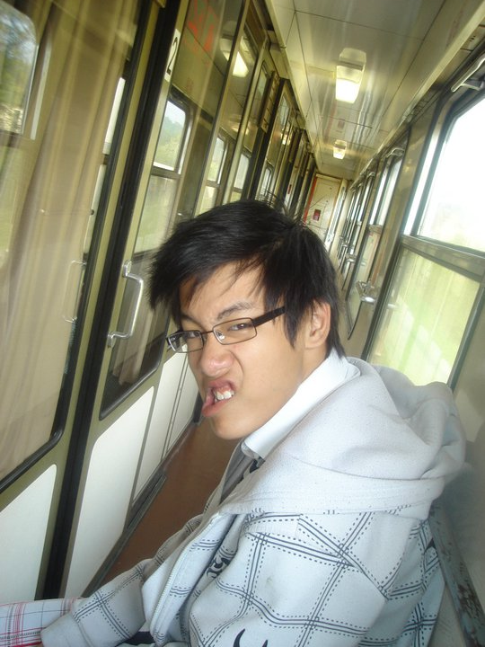
Friends
Nugy
Age: 14
Football
Streeball
Zábřeh
Iw
Age: 15
Camerawork
České Velenice

Slide 11
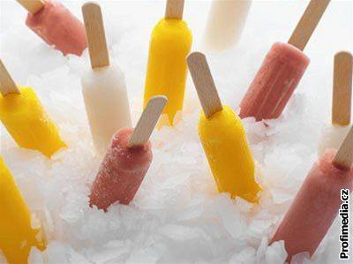
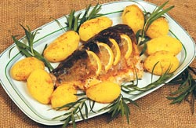
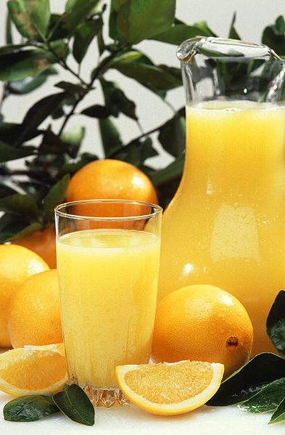
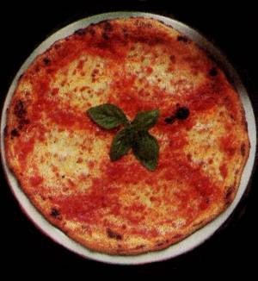
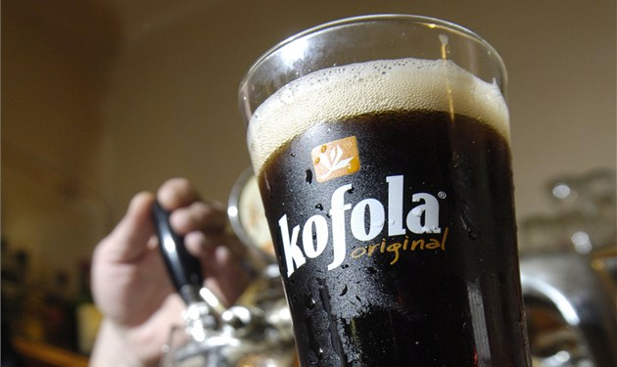
Food
LIKE
DON‘T LIKE

Slide 12

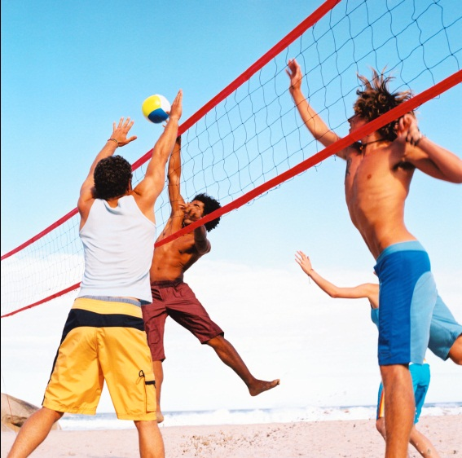
Hobbies
OneRepublic

Slide 13
The End

Slide 14
Sources
Google.com – images
Facebook.com – images
me

